Slide 1
Probabilistic Modeling of Data (contd)
CS771: Introduction to Machine Learning
Piyush Rai

Slide 2
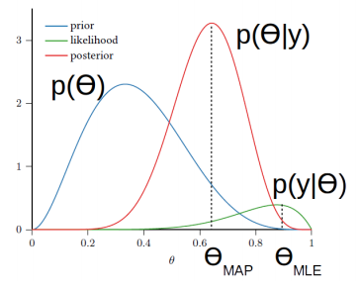


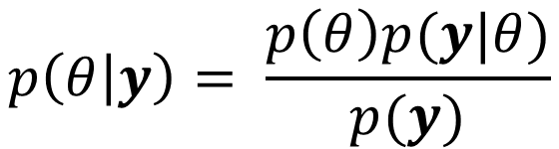

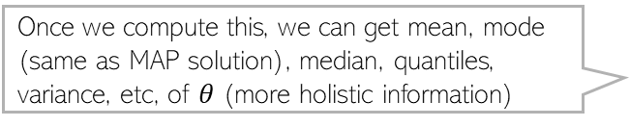
Recap
MLE and MAP used to estimate parameters of probabilistic models
Both provide a “point estimate” of parameters by solving an optimization problem
MAP is akin to doing a regularized MLE (prior also acts as a regularizer for $θ$)
If we want more than just a point estimate, we can compute the full posterior
Maxima of the likelihood function
Assuming i.i.d. observations
$$θ_{MLE}= arg\max_{θ}log p\left(y | θ\right)=arg\max_{θ}\sum_{n=1}^{N}{log p\left(y_{n} | θ\right) }\text{= }arg\min_{θ}\sum_{n=1}^{N}{−log p\left(y_{n} | θ\right)}= arg\min_{θ} NLL(θ)$$
Maxima of the posterior distribution
Can be found even without computing the posterior
Expresses our prior knowledge/belief about the various values of $θ$ can take
$$θ_{MAP}=arg\max_{θ}log p\left(θ | y\right)= arg\max_{θ}[log p\left(y | θ\right)+ log p(θ)= arg\min_{θ} [NLL\left(θ\right)− log p\left(θ\right)]$$
Once we compute this, we can get mean, mode (same as MAP solution), median, quantiles, variance, etc, of $θ$ (more holistic information)
$$p\left(θ | y\right)= \frac{p\left(θ\right)p(y|θ)}{p(y)}$$
Computing the full posterior distribution is in general much harder but if prior and likelihood are conjugate to each other, it is easy

Slide 3

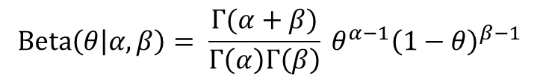
Conjugacy
Many pairs of distributions are conjugate to each other
Bernoulli (likelihood) + Beta (prior) ⇒ Beta posterior
Binomial (likelihood) + Beta (prior) ⇒ Beta posterior
Multinomial (likelihood) + Dirichlet (prior) ⇒ Dirichlet posterior
Poisson (likelihood) + Gamma (prior) ⇒ Gamma posterior
Gaussian (likelihood) + Gaussian (prior) ⇒ Gaussian posterior
and many other such pairs ..
Tip: If two distr are conjugate to each other, their functional forms are similar
Example: Bernoulli and Beta have the forms
Not in the general case but in special cases, e.g., when the variance of the Gaussian likelihood is held fixed and we want to estimate the mean of the Gaussian likelihood using a Gaussian prior on the mean
This is why, when we multiply them while computing the posterior, the exponents get added and we get the same form for the posterior as the prior but with just updated hyperparameter. Also, we can identify the posterior and its hyperparameters simply by inspection
$$Bernoulli\left(y | θ\right)= θ^{y} {(1−θ)}^{1−y}$$
$$Beta\left(θ | α, β\right)= \frac{Γ(α+β)}{Γ\left(α\right)Γ\left(β\right)} θ^{α−1}{\left(1−θ\right)}^{β−1 }$$

Slide 4





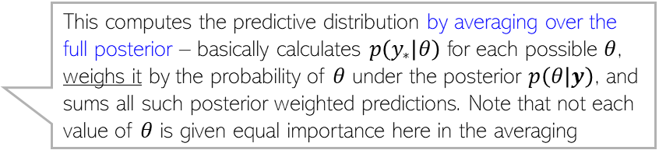

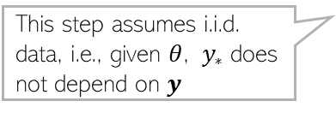
Probabilistic Models: Making Predictions
Having estimated $θ$, we can now use it to make predictions
Prediction entails computing posterior predictive distribution of a new observation $y_{∗}$
When doing MLE/MAP, we approximate the posterior $p(θ|y)$by a single point $θ_{opt}$
Plug-in prediction which uses MLE/MAP of $θ$ is cheaper since no integral involved
Marginalizing (summing/integrating) over the unknown random variable $θ$
$$p\left(y_{∗} | y\right)=∫p\left(y_{∗},θ | y\right)dθ$$
Decomposing the joint using chain rule
Conditional distribution of the new observation, given past observations
$$=∫p\left(y_{∗} | θ, y\right)p(θ|y)dθ$$
In some simple cases, this can be computed exactly but, in general, it can’t be and needs to be approximated
$$=∫p\left(y_{∗} | θ\right)p(θ|y)dθ$$
This step assumes i.i.d. data, i.e., given $θ$, $y_{∗}$ does not depend on $y$
This computes the predictive distribution by averaging over the full posterior – basically calculates $p\left(y_{∗} | θ\right)$ for each possible $θ$, weighs it by the probability of $θ$ under the posterior $p\left(θ | y\right)$, and sums all such posterior weighted predictions. Note that not each value of $θ$ is given equal importance here in the averaging
$${=𝔼}_{p\left(θ | y\right)}[p\left(y_{∗} | θ\right)]$$
$$p\left(y_{∗} | y\right)=∫p\left(y_{∗} | θ\right)p\left(θ | y\right)dθ≈p(y_{∗}|θ_{opt})$$
A “plug-in predictive distribution” - simply plugged in the single best estimate (MLE/MAP) that we have

Slide 5


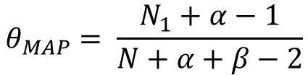
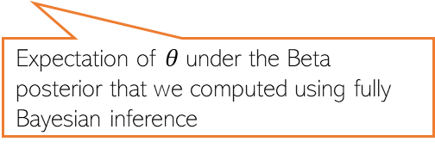

Making Predictions: An Example
For coin-toss example, prediction means computing $p(y_{N+1}=1|y)$
This can be done using the MLE/MAP estimate, or using the full posterior
Thus for this example (where observations are assumed iid from a Bernoulli)
$$θ_{MLE}= \frac{N_{1}}{N}$$
$$θ_{MAP}= \frac{N_{1}+α−1}{N+α+β−2}$$
$$p\left(θ | y\right)= Beta\left(θ | α+N_{1}, β+N_{0}\right)$$
Again, keep in mind that the posterior weighted averaged prediction used in the fully Bayesian case would usually not be as simple to compute as it was in this case. We will look at some hard cases later
Expectation of $θ$under the Beta posterior that we computed using fully Bayesian inference

Slide 6




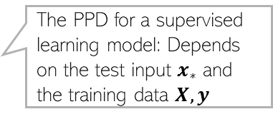

Predictive Distribution: About notation
We used the following notation for the predictive distribution
In some case, as we will see, it may additionally depend on other given quantities
$$p\left(y_{∗} | y\right)=∫p\left(y_{∗} | θ\right)p\left(θ | y\right)dθ$$
Posterior predictive distribution (PPD)
$$p\left(y_{∗} | y\right)≈p(y_{∗}|θ_{opt})$$
Plug-in predictive distribution
An approximation of the PPD using a single best value $θ_{opt}$
$$p(y_{∗}|x_{∗},X,y)$$
The PPD for a supervised learning model: Depends on the test input $x_{∗}$ and the training data $X,y$
$$p(y_{∗}|x_{∗},θ_{opt})$$
The plug-in predictive for a supervised learning model: depends on the test input $x_{∗}$ and the point estimate of $θ$

Slide 7
Probabilistic Models for Supervised Learning

Slide 8
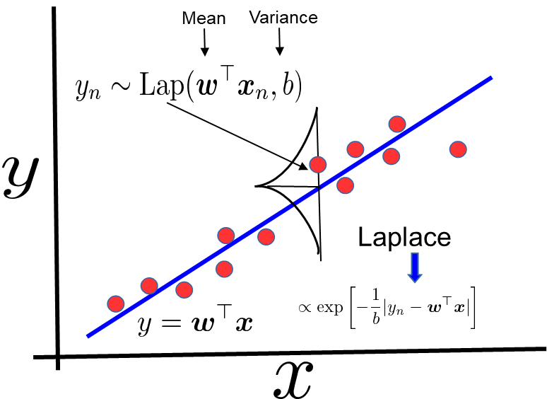

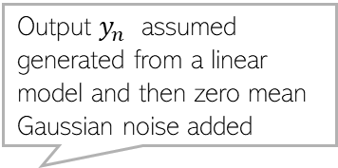



Why Probabilistic Models for Supervised Learning?
We can use a probability distribution to model the input-output relationship
Depending on the nature of the data, we can choose a suitable likelihood model (and it naturally corresponds to a loss function, e.g., squared, cross-entropy, etc)
Output $y_{n}$ assumed generated from a Gaussian with mean $w^{⊤}x_{n}$
Output $y_{n}$ assumed generated from a linear model and then zero mean Gaussian noise added
Mean
Variance
Equivalently:
Note the term in the Gaussian’s exponent – just like a squared error we saw for least squares regression ☺
$$y_{n}= w^{⊤}x_{n}+ε_{n}$$
$ε_{n}∼𝒩(0,$ $β^{−1})$
Likelihood $p\left(y_{n} | x_{n},w\right)= 𝒩(y_{n}|w^{⊤}x_{n},β^{−1})$
Gaussian
Using a Laplace distribution would correspond to using an absolute loss (better model if data has outliers)

Slide 9
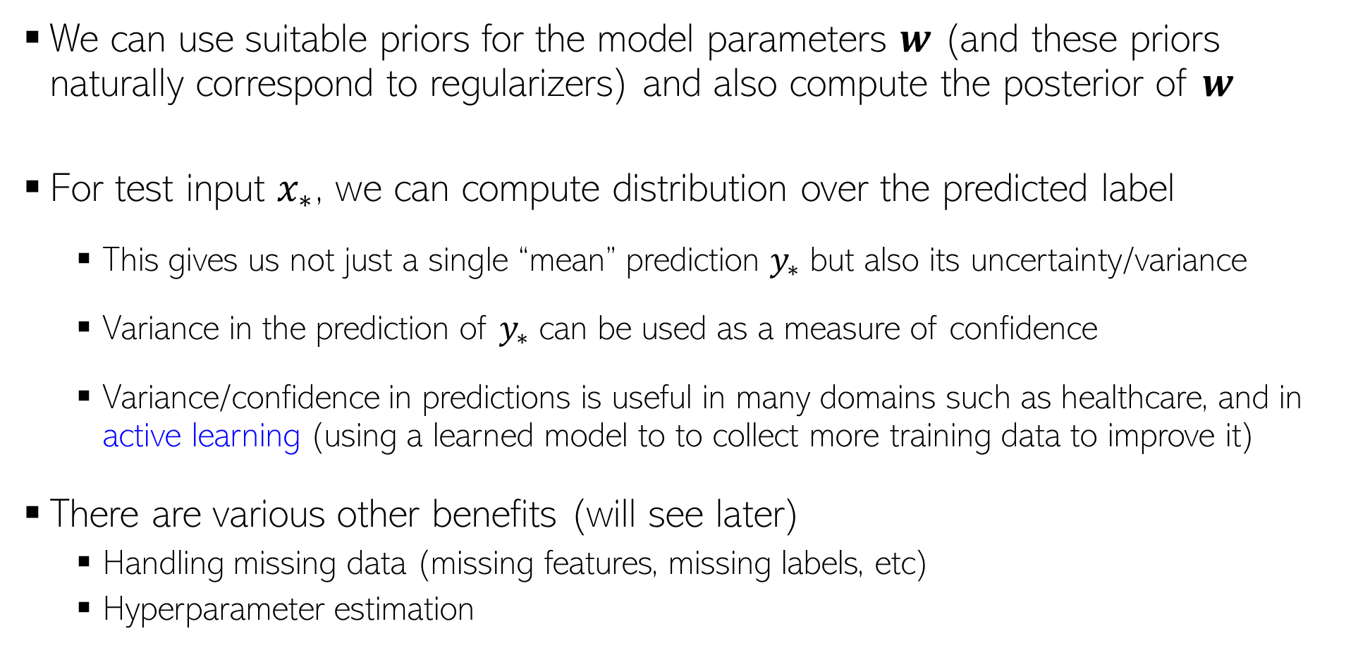

Why Probabilistic Models for Supervised Learning?
We can use suitable priors for the model parameters $w$ (and these priors naturally correspond to regularizers) and also compute the posterior of $w$
For test input $x_{∗}$, we can compute distribution over the predicted label
This gives us not just a single “mean” prediction $y_{∗}$ but also its uncertainty/variance
Variance in the prediction of $y_{∗}$ can be used as a measure of confidence
Variance/confidence in predictions is useful in many domains such as healthcare, and in active learning (using a learned model to to collect more training data to improve it)
There are various other benefits (will see later)
Handling missing data (missing features, missing labels, etc)
Hyperparameter estimation
In form of $p(y_{∗}|x_{∗},X,y)$ or $p(y_{∗}|x_{∗},w_{opt})$

Slide 10
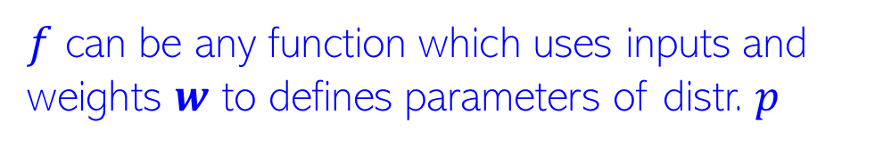
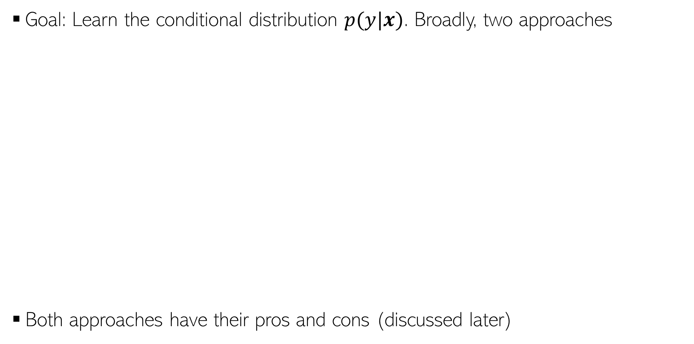
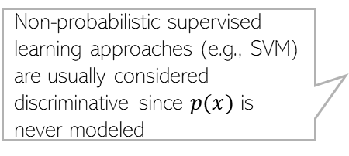
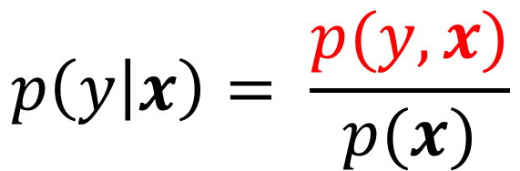

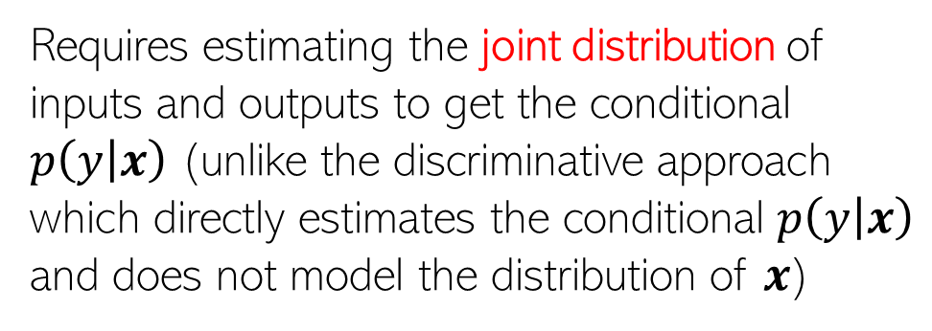
Prob. Models for Supervised Learning
Non-probabilistic supervised learning approaches (e.g., SVM) are usually considered discriminative since $p(x)$ is never modeled
Goal: Learn the conditional distribution $p(y|x)$. Broadly, two approaches
Both approaches have their pros and cons (discussed later)
Discriminative Approach
Generative Approach
$$p\left(y | x\right)=p(y|f\left(x,w\right))$$
$$p\left(y | x\right)= \frac{p(y,x)}{p(x)}$$
$f$ can be any function which uses inputs and weights $w$ to defines parameters of distr. $p$
Requires estimating the joint distribution of inputs and outputs to get the conditional $p\left(y | x\right)$ (unlike the discriminative approach which directly estimates the conditional $p\left(y | x\right)$ and does not model the distribution of $x$)
Some examples
$$p\left(y | x\right)=𝒩(y|w^{⊤}x,β^{−1})$$
$$p\left(y | x\right)=Bernoulli(y|σ(w^{⊤}x))$$

Slide 11
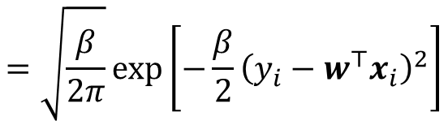


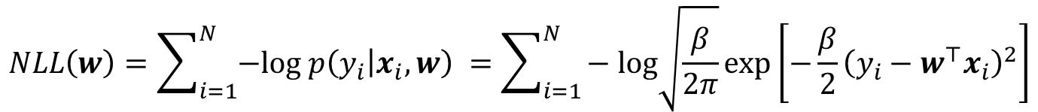
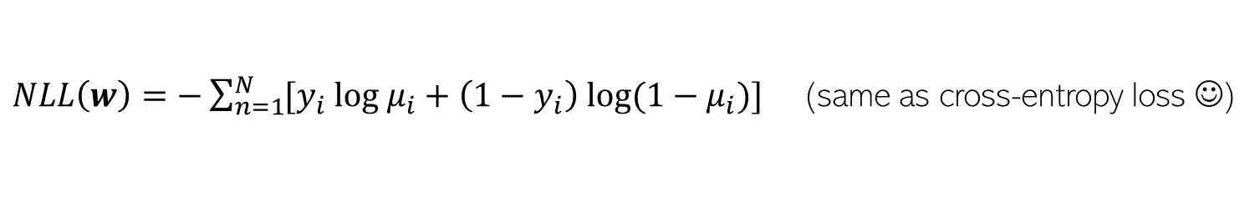

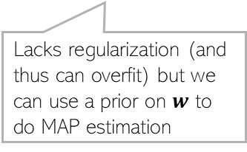
The Discriminative Approach
This approach models $p(y|x)$ directly using a suitable prob. distribution, e.g.,
The negative log-likelihood (assuming i.i.d. outputs) for the above two models
Regression model likelihood
$$=\sqrt{\frac{β}{2π}}exp\left[−\frac{β}{2}{\left(y_{i}−w^{⊤}x_{i}\right)}^{2}\right]$$
$$p\left(y_{i} | x_{i},w\right)=𝒩\left(y_{i} | w^{⊤}x_{i},β^{−1}\right)$$
Binary classification model likelihood
$$μ_{i}={σ(w}^{⊤}x_{i})$$
$$p\left(y_{i} | x_{i},w\right)=Bernoulli(y_{i}|{σ(w}^{⊤}x_{i}))$$
$${=μ}_{i}^{y_{i}}{\left(1−μ_{i}\right)}^{1−y_{i}}$$
$$NLL\left(w\right)=\sum_{i=1}^{N}{−log p\left(y_{i} | x_{i},w\right)} =\sum_{i=1}^{N}{− log\sqrt{\frac{β}{2π}}exp\left[−\frac{β}{2}{\left(y_{i}−w^{⊤}x_{i}\right)}^{2}\right]}$$
Thus minimization of NLL (i.e., doing MLE) is equivalent to minimization of the training loss
$NLL\left(w\right)=\frac{β}{2}\sum_{n=1}^{N}{{\left(y_{i}−w^{⊤}x_{i}\right)}^{2}}$ (same as squared loss ☺)
Lacks regularization (and thus can overfit) but we can use a prior on $w$ to do MAP estimation
$$NLL\left(w\right)=\sum_{i=1}^{N}{−log p\left(y_{i} | x_{i},w\right)} =\sum_{i=1}^{N}{−log μ_{i}^{y_{i}}{\left(1−μ_{i}\right)}^{1−y_{i}}}$$
$NLL\left(w\right)=−\sum_{n=1}^{N}{[y_{i} log μ_{i}+\left(1−y_{i}\right) log(1−μ_{i})]}$ (same as cross-entropy loss ☺)

Slide 12
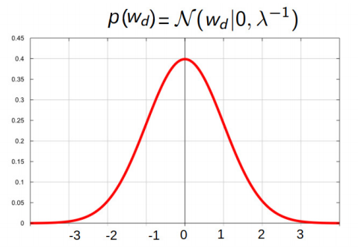


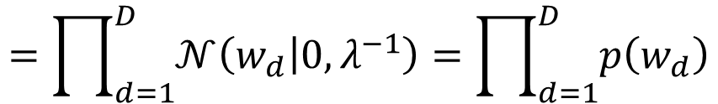
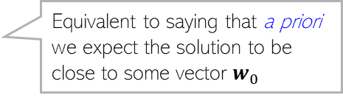
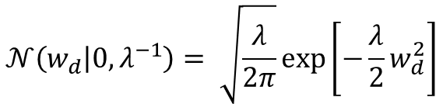


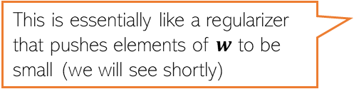
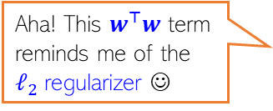
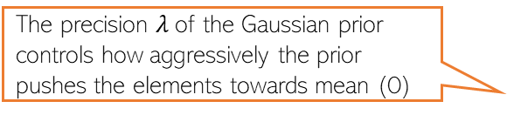


A prior over $w$
For MAP estimation (and to compute full posterior), we need a prior $w∈ℝ^{D}$
A reasonable prior for real-valued vectors can be a multivariate Gaussian
A specific example of a multivariate Gaussian prior in this problem
Equivalent to saying that a priori we expect the solution to be close to some vector $w_{0}$
$Σ$ specifies how strong our belief is that $w$ to close to $w_{0}$
$$p\left(w\right)=𝒩\left(w | w_{0},Σ \right)$$
$$=\prod_{d=1}^{D}{𝒩\left(w_{d} | 0,λ^{−1}\right)}=\prod_{d=1}^{D}{p\left(w_{d}\right)}$$
$$p\left(w\right)=𝒩\left(w | 0,λ^{−1}I_{D} \right)$$
Omitting $λ$for brevity
The precision $λ$of the Gaussian prior controls how aggressively the prior pushes the elements towards mean (0)
Equivalent to saying that a priori we expect each element of the solution to be close to 0 (i.e., “small”)
This is essentially like a regularizer that pushes elements of $w$ to be small (we will see shortly)
$$𝒩\left(w_{d} | 0,λ^{−1}\right)= \sqrt{\frac{λ}{2π}}exp\left[−\frac{λ}{2}w_{d}^{2}\right]$$
Aha! This $w^{⊤}w$ term reminds me of the $ℓ_{2}$regularizer ☺
That’s indeed the case ☺
$$𝒩\left(w | 0,λ^{−1}I_{D} \right)={\left(\frac{λ}{2π}\right)}^{D/2}exp\left[−\frac{λ}{2}\sum_{d=1}^{D}{w_{d}^{2}}\right]={\left(\frac{λ}{2π}\right)}^{D/2}exp\left[−\frac{λ}{2}w^{⊤}w\right]$$

Slide 13
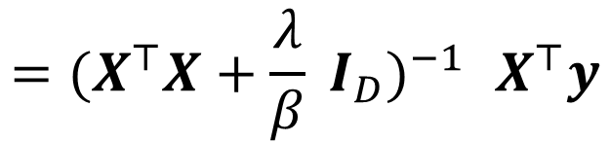
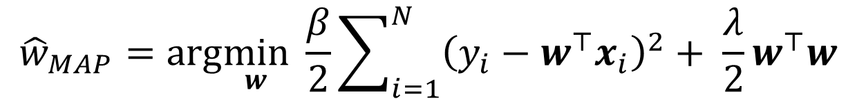
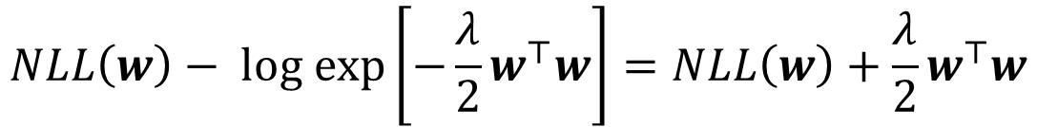
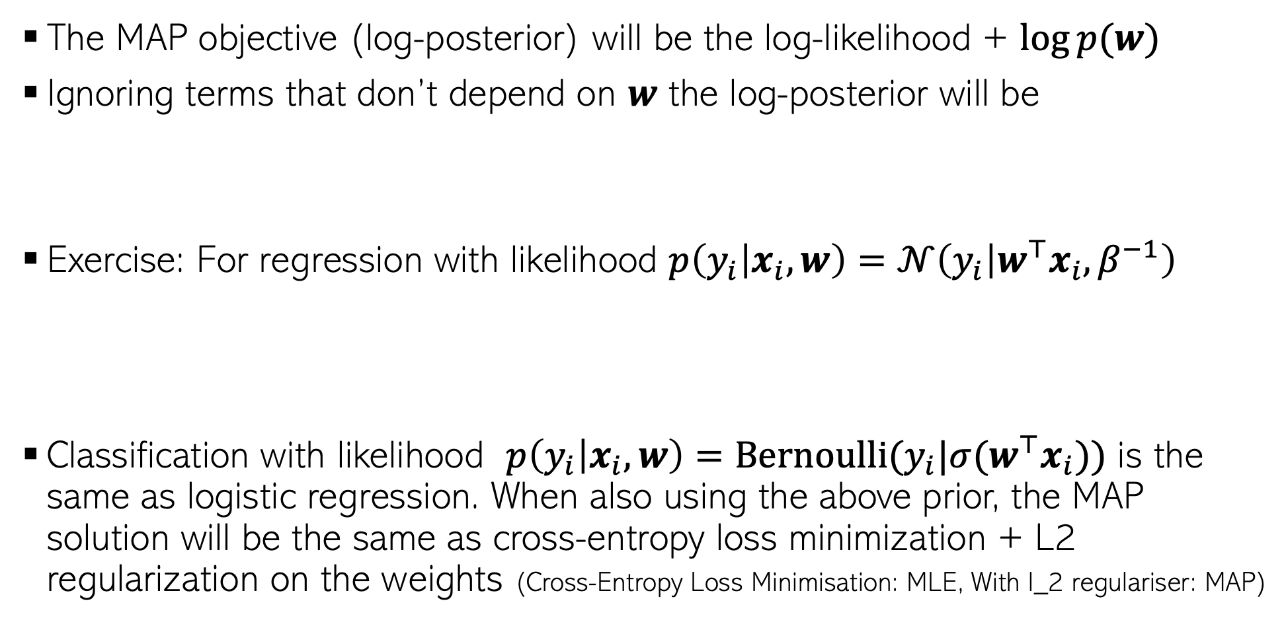
MAP Estimation with $p\left(w\right)= 𝒩(w|0,λ^{−1}I_{D})$
The MAP objective (log-posterior) will be the log-likelihood + $log⁡p(w)$
Ignoring terms that don’t depend on $w$ the log-posterior will be
Exercise: For regression with likelihood $p\left(y_{i} | x_{i},w\right)=𝒩\left(y_{i} | w^{⊤}x_{i},β^{−1}\right)$
Classification with likelihood $p\left(y_{i} | x_{i},w\right)=Bernoulli(y_{i}|{σ(w}^{⊤}x_{i}))$ is the same as logistic regression. When also using the above prior, the MAP solution will be the same as cross-entropy loss minimization + L2 regularization on the weights (Cross-Entropy Loss Minimisation: MLE, With l_2 regulariser: MAP)
$$NLL\left(w\right)− log exp\left[−\frac{λ}{2}w^{⊤}w\right]=NLL\left(w\right)+\frac{λ}{2}w^{⊤}w$$
$${\hat{w}}_{MAP}=arg\min_{w} \frac{β}{2}\sum_{i=1}^{N}{{\left(y_{i}−w^{⊤}x_{i}\right)}^{2}+ \frac{λ}{2}w^{⊤}w}$$
$${=(X^{⊤}X+\frac{λ}{β} I_{D})}^{−1} X^{⊤}y$$

Slide 14
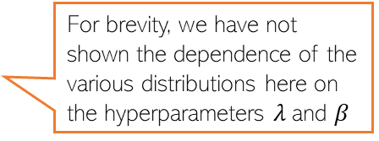





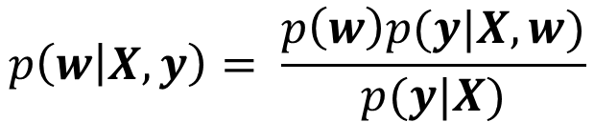
Prob. Linear Regression: The Full Posterior
If we want the full posterior distribution over $w$,, , it can be computed as
For regression, with Gaussian likelihood and zero mean Gaussian prior are conjugate (both Gaussians), and the posterior will be Gaussian
For binary classification with Bernoulli likelihood and zero mean Gaussian prior, we don’t have conjugacy, and the posterior can’t be computed in closed form
$$p\left(w | X,y\right)= \frac{p\left(w\right)p(y|X,w)}{p(y|X)}$$
For brevity, we have not shown the dependence of the various distributions here on the hyperparameters $λ$and $β$
Posterior’s mean is the same as the MAP solution since the mean and mode of a Gaussian are the same!
$$p\left(w | X,y\right)= 𝒩(μ_{N}, Σ_{N})$$
Will provide the proof separately but it is straightforward when using properties of Gaussian
$μ_{N}={(X^{⊤}X+\frac{λ}{β} I_{D})}^{−1}$ $X^{⊤}y$
Note: $λ$and $β$are assumed to be fixed; otherwise, the problem is a bit harder (beyond the scope of CS771)
$$Σ_{N}={({βX}^{⊤}X+λI_{D})}^{−1}$$

Slide 15
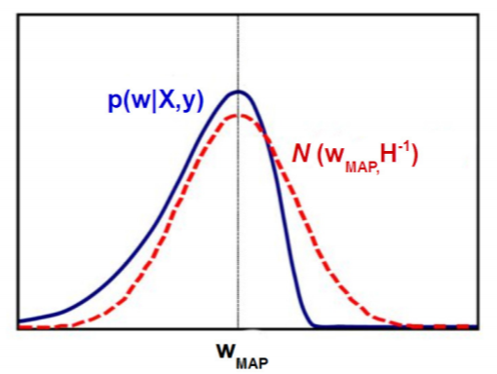
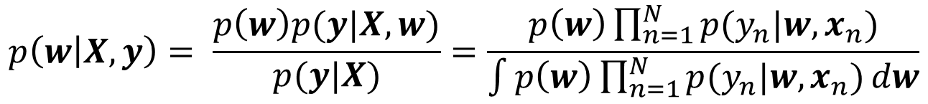
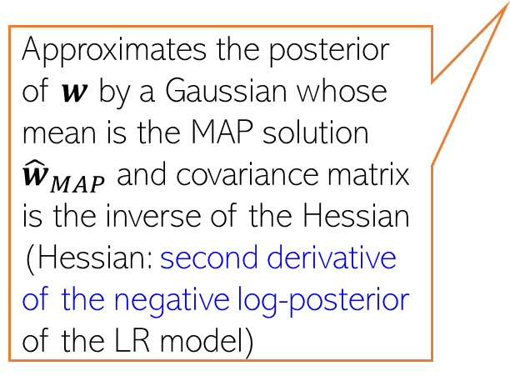
Logistic Regression: The Full Posterior
The posterior distribution for the logistic regression model
Need to approximate the posterior in this case
We will use a simple approximation called Laplace approximation
Gaussian
Bernoulli
Unfortunately, Gaussian and Bernoulli are not conjugate with each other, so analytic expression for the posterior can’t be obtained unlike prob. linear regression
$$p\left(w | X,y\right)= \frac{p\left(w\right)p(y|X,w)}{p(y|X)}=\frac{p\left(w\right)\prod_{n=1}^{N}{p(y_{n}|w,x_{n})}}{\int{p\left(w\right)\prod_{n=1}^{N}{p(y_{n}|w,x_{n})}dw}}$$
Approximates the posterior of $w$ by a Gaussian whose mean is the MAP solution ${\hat{w}}_{MAP}$ and covariance matrix is the inverse of the Hessian (Hessian: second derivative of the negative log-posterior of the LR model)
Can also employ more advanced posterior approximation methods, like MCMC and variational inference (beyond the scope of CS771)

Slide 16
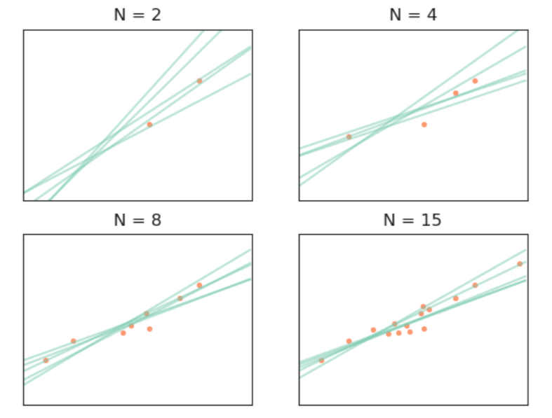
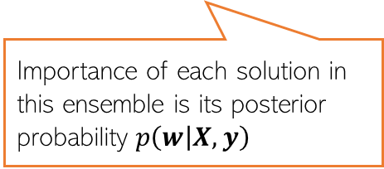
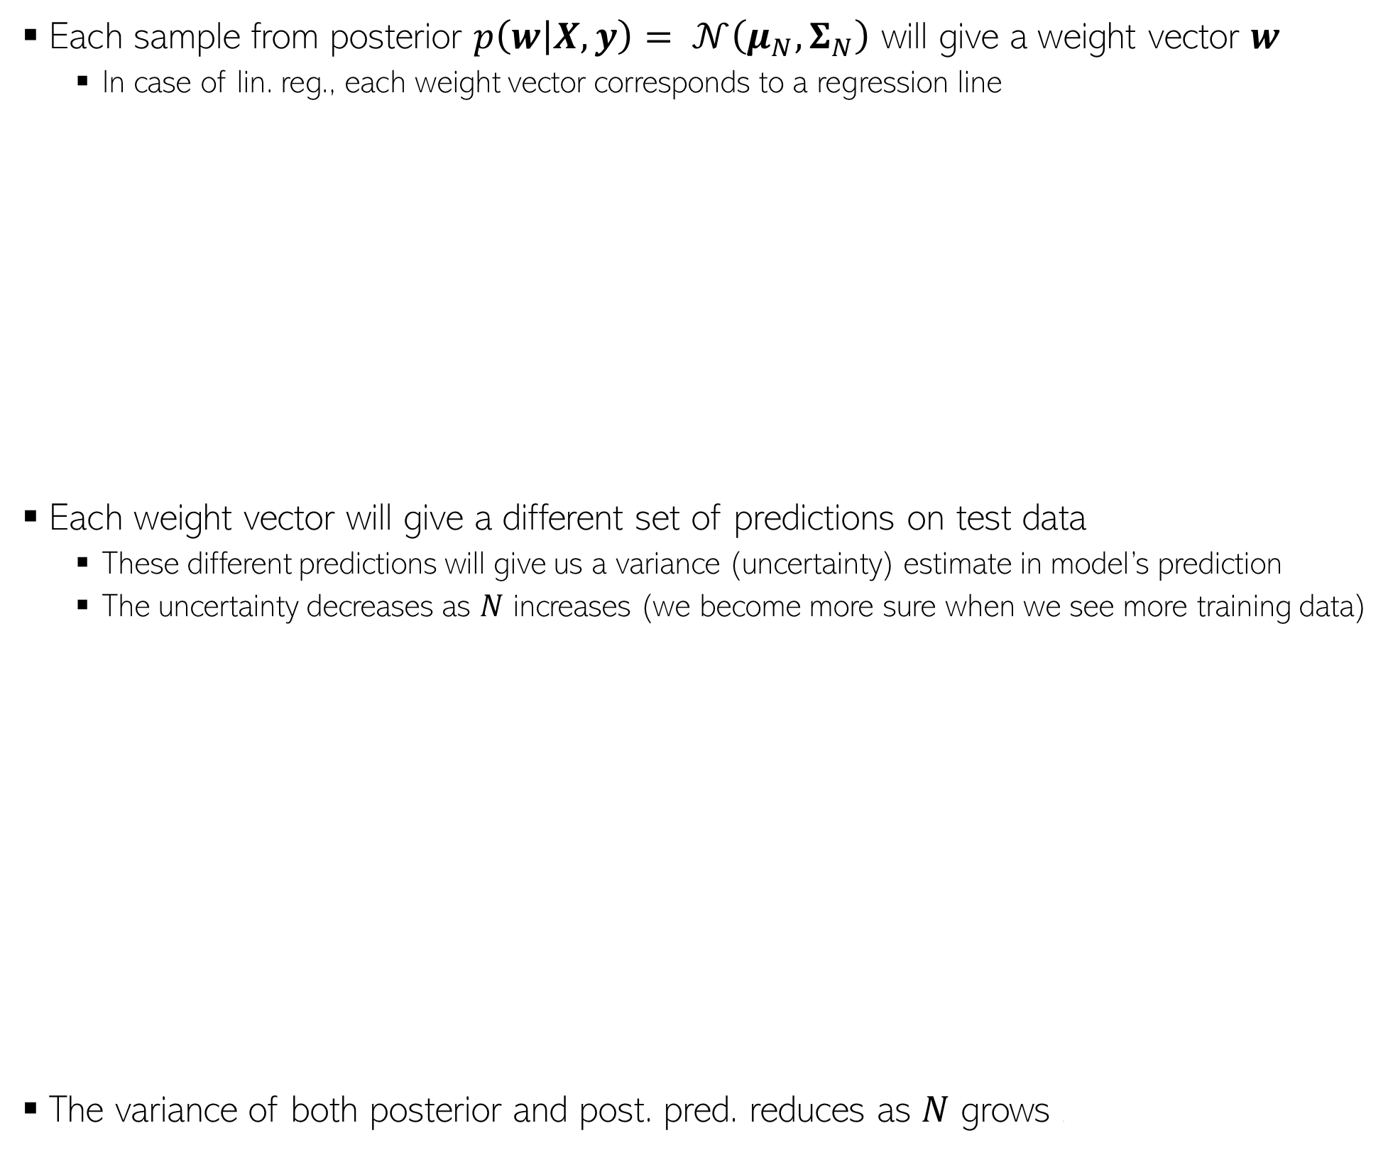
What does posterior of a linear model look like ?
Each sample from posterior $p\left(w | X,y\right)= 𝒩\left(μ_{N}, Σ_{N}\right)$ will give a weight vector $w$
In case of lin. reg., each weight vector corresponds to a regression line
Each weight vector will give a different set of predictions on test data
These different predictions will give us a variance (uncertainty) estimate in model’s prediction
The uncertainty decreases as $N$ increases (we become more sure when we see more training data)
The variance of both posterior and post. pred. reduces as $N$ grows (
The posterior sort of represents an ensemble of solutions (not all are equally good but we can use all of them in an “importance-weighted” fashion to make the prediction using the posterior predictive distribution)
Importance of each solution in this ensemble is its posterior probability $p\left(w | X,y\right)$
Pic source: https://waterprogramming.wordpress.com/

Slide 17

What does posterior of a linear model look like ?
Can also sample from the Laplace approximate posterior of logistic regression
Each sample will give a weight vec defining a hyperplane separator
Not all separators are equally good; their goodness depends on their posterior probabilities
When making predictions, we can still use all of them but weighted by their importance based on their posterior probabilities
That’s exactly what we do when computing the predictive distribution

Slide 18





Prob. Linear Regression: Predictive Distribution
Want the predictive distribution $p(y_{∗}|x_{∗}, X, y)$of the output $y_{∗}$ for a new input $x_{∗}$(
With MLE/MAP estimate of $w$, we will use the plug-in predictive
If we have the full posterior over $w$, can compute the posterior predictive dist.
Requires an integral but has a closed form
Input-specific predictive uncertainty useful in problems where we want confidence estimates of the predictions made by the model (e.g., Active Learning)
Assuming the hyperparameters $λ$and $β$ are known (otherwise, the PPD can’t be computed exactly)
Mean prediction
Input-specific predictive variance unlike the MLE/MAP based predictive where it was $β^{−1}$ (and was same for all test inputs)
Will provide the proof separately but it is straightforward when using properties of Gaussian

Slide 19


Logistic Regression: Predictive Distribution
When using MLE/MAP solution ${\hat{w}}_{opt}$, can use the plug-in predictive distribution
When using fully Bayesian inference, we must compute the posterior predictive
$p\left(y_{∗}=1 | x_{∗},X,y\right)=\int{p\left(y_{∗}=1 | {w,x}_{∗}\right)p\left(w | X,y\right)dw}$
$$≈p\left(y_{∗}=1 | {{\hat{w}}_{opt},x}_{∗}\right)=σ({{\hat{w}}_{opt}}^{⊤}x_{n})$$
$p\left(y_{∗} | x_{∗},X,y\right)=Bernoulli[σ({{\hat{w}}_{opt}}^{⊤}x_{n})]$
$p\left(y_{∗}=1 | x_{∗},X,y\right)=\int{p\left(y_{∗}=1 | {w,x}_{∗}\right)p\left(w | X,y\right)dw}$
Integral not tractable and must be approximated
sigmoid
Gaussian (if using Laplace approx.)
Monte-Carlo approximation of this integral is one possible way
Generate $M$ samples $w_{1}, w_{2}, …, w_{M}$, from the Gaussian approx. of posterior and use $p\left(y_{∗}=1 | x_{∗},X,y\right)≈\frac{1}{M}\sum_{m=1}^{M}{p\left(y_{∗}=1 | {w_{m},x}_{∗}\right)}=$ $\frac{1}{M}\sum_{m=1}^{M}{σ(w_{m}^{⊤}x_{n})}$

Slide 20
Coming up..
The generative approach to supervised learning

